Slide 1

ABC CALL VOLUME TREND ANALYSIS

Slide 2

CONTEXT
Project description
Approach
Tech stack used
Analysis
Insights

Slide 3

PROJECT DESCRIPTION
This project focuses on customer care calls from the insurance category in ABC company.
The objective is to analyze these calls over a full day to determine various metrics, such as the average number of calls, total call volume, abandon rate, and the number of additional agents required to ensure a positive customer experience.

Slide 4

APPROACH
For this project, I have taken the approach of using Microsoft Excel to create a pivot table that summarizes the call volume data by different categories such as date, time of day, call type, etc. This will allow you to easily analyze the trends and patterns in the call volume over time. Next, I have used assumptions about the call volume trends to estimate how many people are required for night shifts. For example, if the call volume tends to peak during certain times of the day, you can assume that more people will be needed during those times.

Slide 5

TECH STACK USED
Microsoft Excel
PowerPoint

Slide 6

ANALYSIS

Slide 7
AVERAGE CALL TIME DURATION
We are required to determine the mean duration of every incoming call received by the agents according to each time bucket. To do so, I have generated a pivot table that uses the time bucket and call_seconds column, and I have used the call status to filter out the unanswered calls from the entire dataset. Finally, I have constructed a bar chart to showcase the average call duration.
Time_bucket | Average of Call_Seconds (s)
10_11 | 203.33
11_12 | 199.26
12_13 | 192.89
13_14 | 194.74
14_15 | 193.68
15_16 | 198.89
16_17 | 200.87
17_18 | 200.25
18_19 | 202.55
19_20 | 203.41
20_21 | 202.85
9_10 | 199.07
Grand Total | 198.62

Slide 8
Row Labels | Count of Time | Count of Customer_Phone_No
10_11 | 11.28% | 13313
11_12 | 12.40% | 14626
12_13 | 10.72% | 12652
13_14 | 9.80% | 11561
14_15 | 8.95% | 10561
15_16 | 7.76% | 9159
16_17 | 7.45% | 8788
17_18 | 7.23% | 8534
18_19 | 6.13% | 7238
19_20 | 5.48% | 6463
20_21 | 4.67% | 5505
9_10 | 8.13% | 9588
(blank) | 0.00%
Grand Total | 100.00% | 117988
TOTAL NUMBER OF CALLS
I've generated a pivot table to calculate the total number of calls made in a day. The table includes the time_bucket, time, and customer phone_no columns with unique values. Using this table, I've created a bar chart that shows the percentage of time for each count and the count of customer_phone_no.

Slide 9
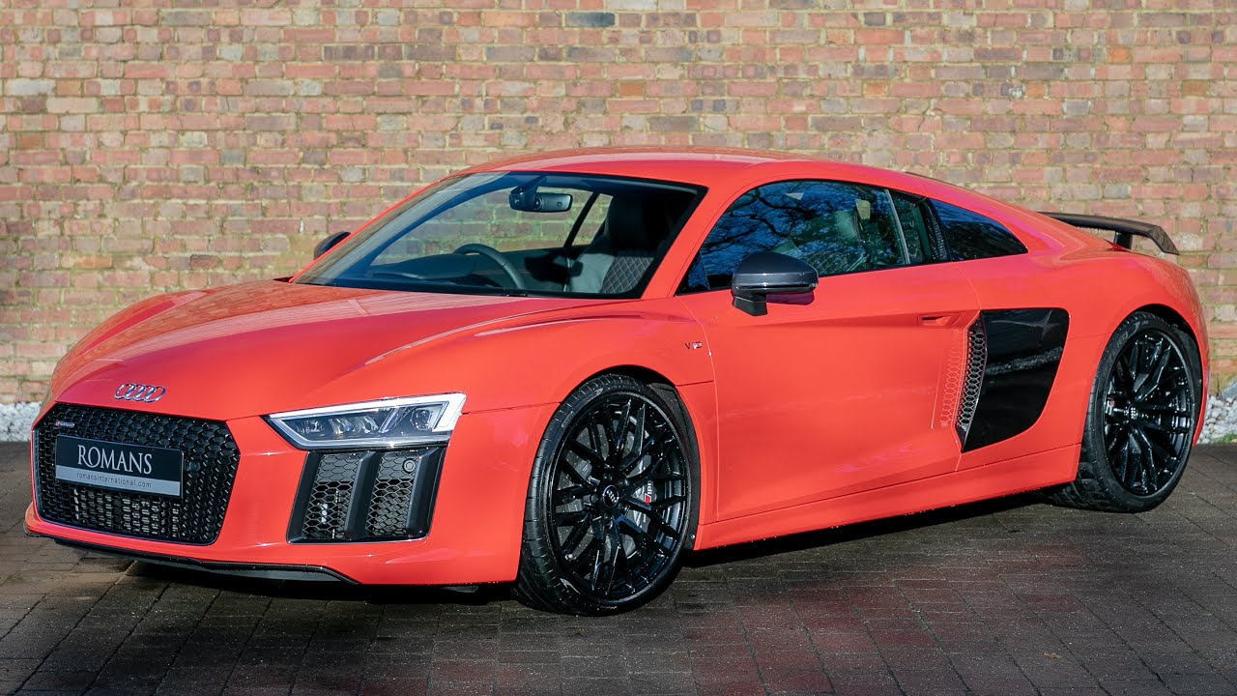


MANPOWER REQUIRED
We need to find out how many more agents are required if the call attending rate is 90%.
To find out the manpower required for 90% of the calls to get connected, I have made an assumption about employees’ working hours.
Total working hours by the company | 9 hrs
Break | 1.5 hrs
IT Downtime | 0.5 hrs
Meetings | 1 hr
Total working hours by employee | 5 hrs
Total working hours are fixed by the company as 9 hrs, if the employee takes a 1.5 hr break for lunch and snacks then the employee will work only for 5 hrs.
Based on this we need to find out how many more employees are required to fill 90% of calls.

Slide 10

MANPOWER REQUIRED
To begin with, we must determine the overall call duration for an entire day by utilizing a pivot table.
For this purpose, I have chosen January 1st to calculate the total call duration.
If we convert the total call duration of 676664 seconds into hours, it would be equivalent to 187 hours and 57 minutes, which can be represented as 187.96 hours.
Date | Sum of Call_Seconds (s)
01-Jan | 676664
Grand Total | 676664

Slide 11
MANPOWER REQUIRED
Next, we need to calculate the total number of agents required by dividing the average number of calls handled by a single agent in a day by the time spent by one agent in a day.
Total agents = 187.96/5 = 37.59
Assuming that agents work for 5 hours a day and 60% of calls are answered, we can use a unitary method to calculate how many additional employees we would need to connect 90% of the calls.
Total agents required for 90% of calls =
(90*37.59)/60 = 56.3
Since we cannot hire fractional employees, we will hire 56 agents instead of 56.3 agents.
Now among these 56 agents, we need to calculate how many employees will be allotted to each bucket.
To calculate that, I have used the round function
=ROUND(AJ16*56,0)
time bucket | Count of Call_Seconds (s) | Count of Call_Seconds (s)2 | Man required
10_11 | 11.28% | 0.11 | 6
11_12 | 12.40% | 0.12 | 7
12_13 | 10.72% | 0.11 | 6
13_14 | 9.80% | 0.10 | 5
14_15 | 8.95% | 0.09 | 5
15_16 | 7.76% | 0.08 | 4
16_17 | 7.45% | 0.07 | 4
17_18 | 7.23% | 0.07 | 4
18_19 | 6.13% | 0.06 | 3
19_20 | 5.48% | 0.05 | 3
20_21 | 4.67% | 0.05 | 3
9_10 | 8.13% | 0.08 | 5
(blank) | 0.00% | 0.00 | 0
Grand Total | 100.00% | 100.00% | 56

Slide 12
NIGHT SHIFT AGENTS’ REQUIREMENT
The ABC company receives calls even during the night, but due to the absence of agents working the night shift, they are unable to attend to these calls.
This can potentially harm the company's rating.
Assuming that there are 100 calls received from 9 am to 9 pm and 30 calls received from 9 pm to 9 am, we need to determine the number of agents needed to cover the night shift.
To do this, we first need to calculate the average duration of daytime calls.
To achieve this, I have generated a pivot table that includes the columns for date, time, and call status.
Using this table, I have calculated the average duration of all calls received.
Days | Abandon | Answered | Transfer | Total
01-Jan | 684 | 3883 | 77 | 4644
02-Jan | 356 | 2935 | 60 | 3351
03-Jan | 599 | 4079 | 111 | 4789
04-Jan | 595 | 4404 | 114 | 5113
05-Jan | 536 | 4140 | 114 | 4790
06-Jan | 991 | 3875 | 85 | 4951
07-Jan | 1319 | 3587 | 42 | 4948
08-Jan | 1103 | 3519 | 50 | 4672
09-Jan | 962 | 2628 | 62 | 3652
10-Jan | 1212 | 3699 | 72 | 4983
11-Jan | 856 | 3695 | 86 | 4637
12-Jan | 1299 | 3297 | 47 | 4643
13-Jan | 738 | 3326 | 59 | 4123
14-Jan | 291 | 2832 | 32 | 3155
15-Jan | 304 | 2730 | 24 | 3058
16-Jan | 1191 | 3910 | 41 | 5142
17-Jan | 16636 | 5706 | 5 | 22347
18-Jan | 1738 | 4024 | 12 | 5774
19-Jan | 974 | 3717 | 12 | 4703
20-Jan | 833 | 3485 | 4 | 4322
21-Jan | 566 | 3104 | 5 | 3675
22-Jan | 239 | 3045 | 7 | 3291
23-Jan | 381 | 2832 | 12 | 3225
average | 1495.78 | 3584.87 | 49.26 | 5129.91

Slide 13
NIGHT SHIFT AGENTS’ REQUIREMENT
I have rounded up the average calls daily(9am – 9pm) to 5130
For every 100 calls in the morning shift, there are 30 calls in the night shift, I have used the round function to calculate night-time call duration
=ROUND(5130*0.3,0)=1539
Additional hours required for night calls is 76.4 hrs
=5130* 198.6(avg of call_seconds)*0.9/3600=76.4
Additional agents required for night calls is 15.
=ROUND(76.4/5,0)
so I have divided the time duration with 30
Call duration/30
After the time duration, by using the round function, I calculated the agents required for each time bucket.
night call (9 pm – 9 am) | call distribution | time duration | agents required | Agents required2
9pm - 10 pm | 3 | 0.10 | 1.5 | 2
10pm - 11 pm | 3 | 0.10 | 1.5 | 2
11pm - 12 pm | 2 | 0.07 | 1 | 1
12pm - 1 am | 2 | 0.07 | 1 | 1
1am - 2am | 1 | 0.03 | 0.5 | 1
2am - 3am | 1 | 0.03 | 0.5 | 1
3am - 4am | 1 | 0.03 | 0.5 | 1
4am - 5am | 1 | 0.03 | 0.5 | 1
5am - 6am | 3 | 0.10 | 1.5 | 2
6am - 7am | 4 | 0.13 | 2 | 2
7am - 8am | 4 | 0.13 | 2 | 2
8am - 9am | 5 | 0.17 | 2.5 | 3
Total | 30 | 1 | 15 | 19

Slide 14

INSIGHTS
I gained knowledge about the ways in which an analyst can influence the customer service department to enhance customer satisfaction. The project was straightforward as the provided data already included calculated time buckets and call durations in seconds, eliminating the need for further calculations. Additionally, I gained insight into the concept of behavioral analytics.

Slide 15
THANK YOU

